Slide 1
Ethiopian Public Health Institute (EPHI)
Introduction

Slide 2
Outline
Background
Introduction to DHSI2
Basics of DHIS2
Building Blocks DHIS2
Getting Started With DHIS2

Slide 3
Background
The Center for Public Health Emergency Management (PHEM) Early Warning and Information System Management Preparedness Directorate (EWISMPD) of the Ethiopian Public Health Institute (EPHI) has selected Dhis2 as an electronic reporting platform as of May 2018.
EPHI/PHEM, in collaboration with MOH and Partners, has managed to incorporate a separate PHEM application in DHIS2 to address the existing inefficiencies in its surveillance system and in an attempt to modernize electronic data reporting and data management.
This helps to improve data management and quality and is used for data-driven decision-making in outbreak control and prevention, early warning, and communication of risks to the public and stakeholders.

Slide 4
Introduction
What is DHIS2?

Slide 5
Introduction
What is DHIS2?
DHIS2 is a tool for collecting, validating, analyzing, and presenting aggregate and individual data.
It is a platform and database-independent open-source tool.
It is a generic tool that can be easily customized to fit any field that is dependent on data collected and analyzed for decision-making.

Slide 6
Introduction
It has a flexible user interface and provides easy access for field epidemiologist, planners, managers and monitoring and evaluation specialists to design and collect important data.

Slide 7
Use of DHIS2 in HIS
DHIS2 supports the different facets of the information cycle, including:
Collecting data
Running quality checks.
Allow data access at multiple levels.
Reporting.
Making graphs, maps, and other forms of analysis.
Enabling comparison across time (for example, previous months) and space (for example, across facilities and districts)
See trends (displaying data in a time series to see their min and max levels).

Slide 8
Technical Specification
DHIS2 works both offline and online, is easy to use, and is developed.
DHIS2 is an open-source software that can be used at no cost.

Slide 9
History of DHIS 2
DHIS 2 is developed by the Health Information Systems Program (HISP) – a University of Oslo program
Design to collect, process, analyze, and present data
The first country where DHIS was piloted in is South Africa (and the first to adopt it as a national system)
The first version of the software DHIS 1.3 and its subsequent version DHIS 1.4
Was implemented in some countries, including South Africa, Mozambique, Nigeria, India, and Ethiopia

Slide 10
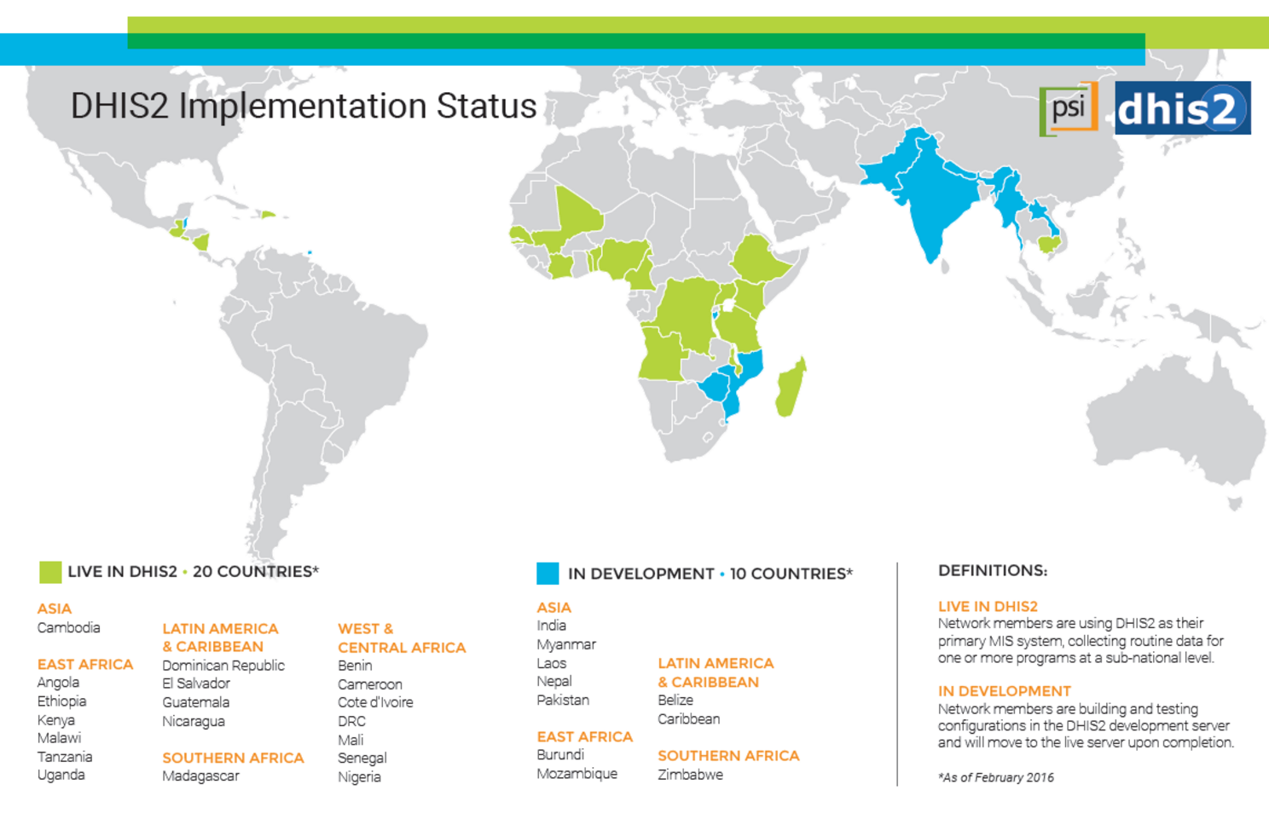
History of DHIS 2

Slide 11
The Basics: What is DHIS2? …
Capturing, analysis, and dissemination of data
Handles routine data, events, and surveys
Communication (messaging and feedback)
Open source, web-based software platform
Global network initiative with local nodes.

Slide 12

The Building Blocks
The Building Blocks

Slide 13
Data Dimensions in DHIS2
A data value or a data captured in DHIS 2 needs at least three dimensions that answer three questions: the WHERE, the WHEN and the WHAT.
Consider these questions:
  Number of Malaria inpatient cases
  Number of cholera death

Slide 14
Data Dimensions in DHIS2
All of them cannot make sense unless they are collected for a specific health facility [the ‘Where’] at a specific time [the ‘When’] – while they answer the ‘What’ question.

Slide 15
The WHERE: Organization units
Organization unit : hierarchy of health facilities in a specific country or locality
  Ex-1:Ethiopia➔ Eth Somali➔ Afder➔ Hargelle Wereda ➔ Dharahaye PHCU ➔ Harder HP
  Ex-2: Ethiopia➔ Tigray➔ Mekelle ZHD➔ Ayder Referall Hospital
DHIS provides tools to add, edit, delete, move or merge organization units
    in case of new facilities, name changes, removal, moving of facilities or admin units to safeguard historical data
Administrators of DHIS 2 or other people with relevant authorities can create the organization unit structure in DHIS 2.

Slide 16
The WHEN: Periods
DHIS 2 has 17 pre-defined frequencies/period-types for data collection and analysis:
  Daily, weekly (and variants), monthly, bimonthly, quarterly, six-monthly (and variants), yearly (and variants)
It also has relative periods used for analyses purposes– e.g., yesterday, this week, last 12 months, last 3 quarters, last 6 months, last 5 years.

Slide 17
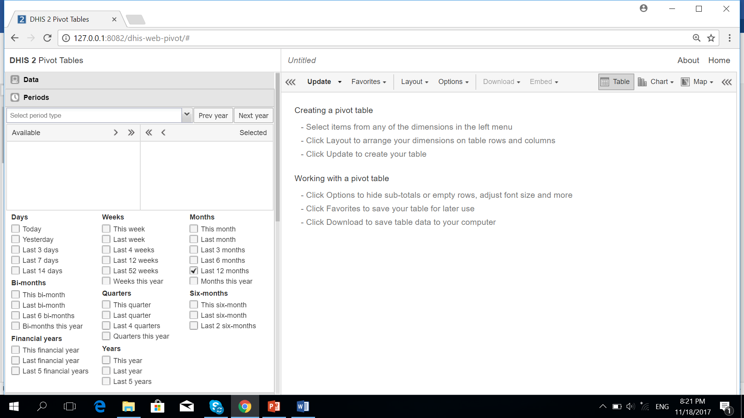
The WHEN: Relative Periods …

Slide 18
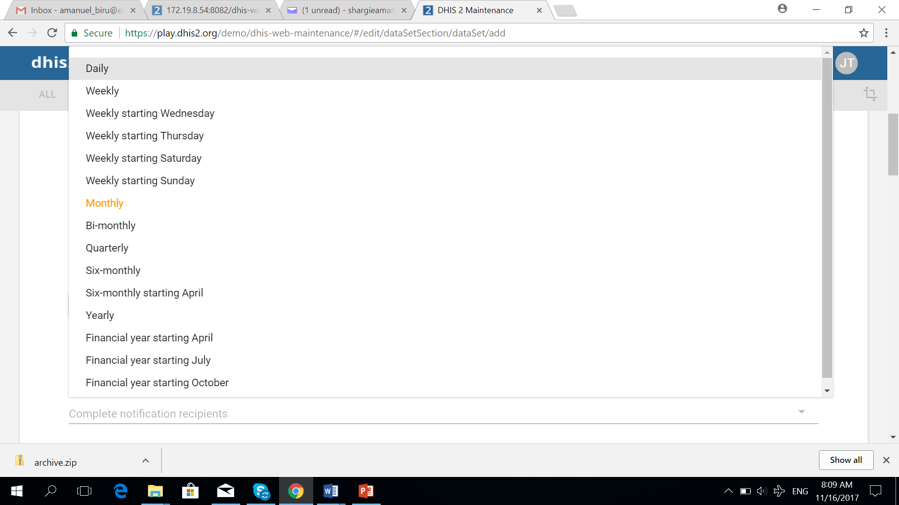
The WHEN: Fixed Periods …

Slide 19
The WHAT: Data Elements
Examples of data elements include
  Number of Malaria inpatient cases
  Number of cholera death
Data elements in DHIS2 can be of:
  Either aggregate or individual[tracker] domain;
  Data type Number, Text, Yes/No, Date value, etc.
  Can have Average, Sum[Sum in Org Unit Hierarchy], Count, rate, ratio, Standard Deviation, Variance, Minimum or Maximum aggregation operators.

Slide 20
Indicators

Slide 21
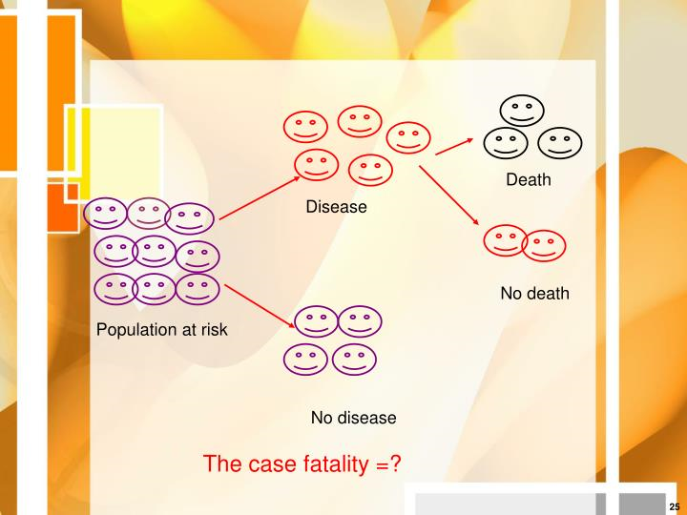
Indicator
Moving from Data elements to Indicators: Context

Slide 22
Indicator
Indicators are variables that help to measure changes, directly or indirectly
Indicators are tools that help comparison of performance across different facilities or different periods.
While data elements can show raw data, indicators are calculated from data elements.
There are different type of indicators ( number, proportion, rate and ratio).

Slide 23
Getting Started DHIS2

Slide 24
How to Access DHIS2
To access the EPHI PHEM Data entry/Production server:
URL: https://staging.ephi.gov.et
Once the site has loaded, to log in, write the username and password in their respective fields and click the Sign in Button

Slide 25
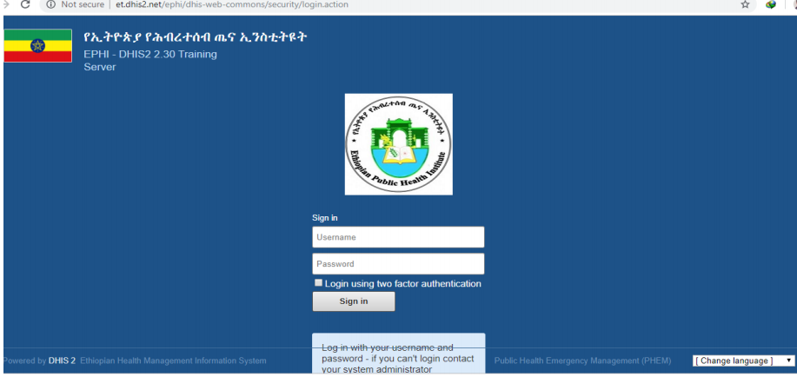
How to Access DHIS2

Slide 26
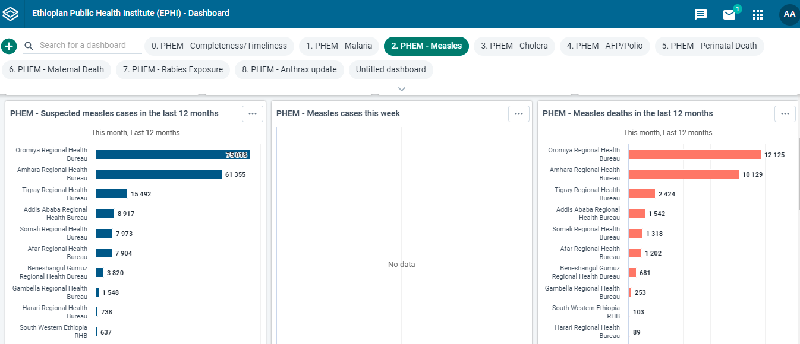
DHIS2 Environment ---Dashboard

Slide 27
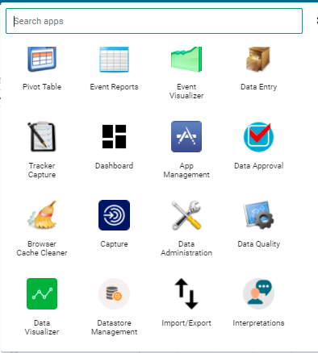
DHIS2 APP
List of DHIS2
Apps.
Search App

Slide 28
APP
What do you want?
1. Enter data: aggregate data, event with and without registration.
  Use: data entry app, capture app.
2. Analyze data: use table, chart, map, dashboard
  Use: pivot table, data visualizer, map,
3. Control data quality: data quality

Slide 29
APP
What do you want?
4. Manage users and authorities: Create or edit users, user roles or user groups.
  Use: user app
5. Configure metadata: Create metadata, for example organization units and data elements.
  Use: maintenance app

Slide 30
DHIS2 Environment …
DHIS 2 provides functionality to exchange messages within and outside the system as feedback mechanism
Messages can be written to specific users within the system.
They can also be sent to their e-mail address provided along with their profile
It also provides a platform to send SMS to individual users
Users who have privileges to access the dashboard can send messages to a user or a group of users feedbacks and interpretations
The messages users receive within the system appear at the dashboard.

Slide 31
Thank you!

